Slide 1


Exhib
An exhibition Management System
Henrik Klarup
Jesper Riemer Andersen
Simon Reedtz Olesen
Jacob Karstensen Wortmann
Nicklas Andersen

Slide 2
Agenda
Motivation
Concept
Application Design
Application implementation
Website
Server communication
Results and findings
Demonstration
2 OF 17 | 15.02.2014
Department of computer science
AALBORG UNIVERSITy

Slide 3
Motivation
Jacob K. Wortmann

Slide 4
Motivation
concept
App design
Floor plan
Website
Server communication
conclusion
demonstration
System Motivation
Single application for multiple information and navigation purposes.
Indoors navigation.
Sharing of relevant information to users.
Simple administration tool to the organisers.
4 OF 17 | 15.02.2014
Department of computer science
AALBORG UNIVERSITy

Slide 5
Concept
Jacob K. Wortmann

Slide 6
Motivation
concept
App design
Floor plan
Website
Server communication
conclusion
demonstration
The exhib Concept
Example: Exhibition
Organisers generate the floor plan and data.
Visitor/user enters and scans a NFC tag to enter
The user can subscribe to different booths to gain relevant information(by feeds).
Can see a schedule of the overall exhibition.
Can navigate to different booths with the floor plan and by use of NFC tags to register the user’s location.
6 OF 17 | 15.02.2014
Department of computer science
AALBORG UNIVERSITy

Slide 7
Application Design
Simon Reedtz

Slide 8
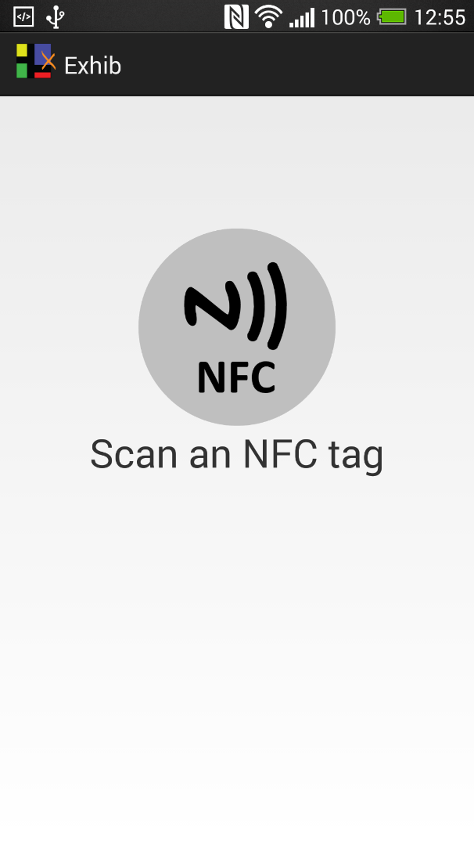
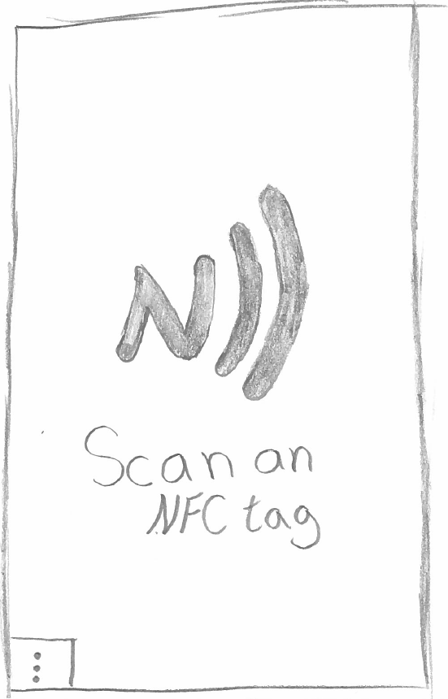
Motivation
concept
App design
Floor plan
Website
Server communication
conclusion
demonstration
TeST
8 OF 17 | 15.02.2014
Department of computer science
AALBORG UNIVERSITy

Slide 9
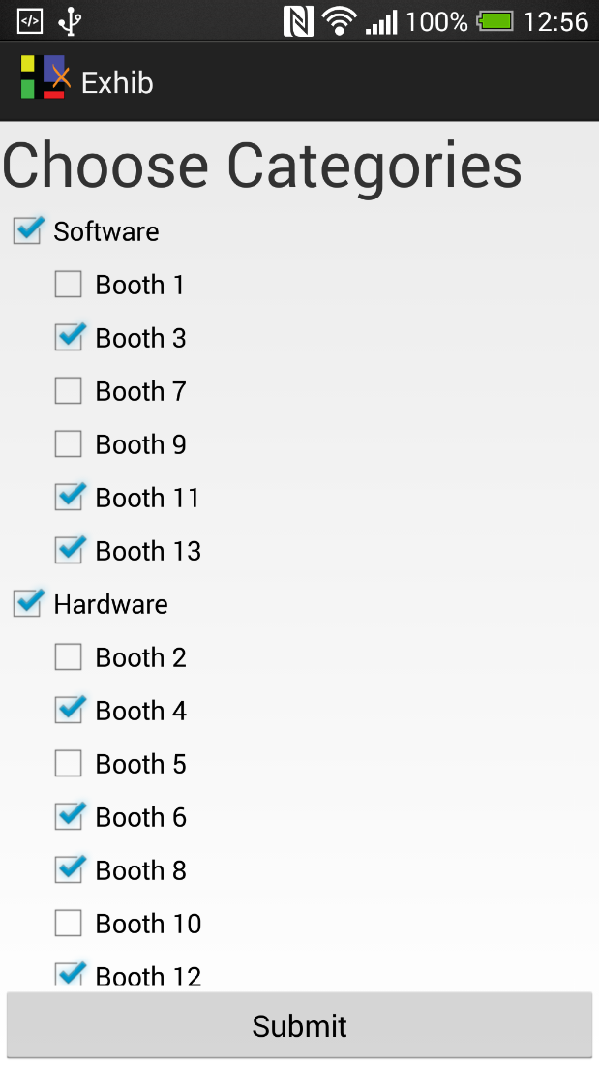
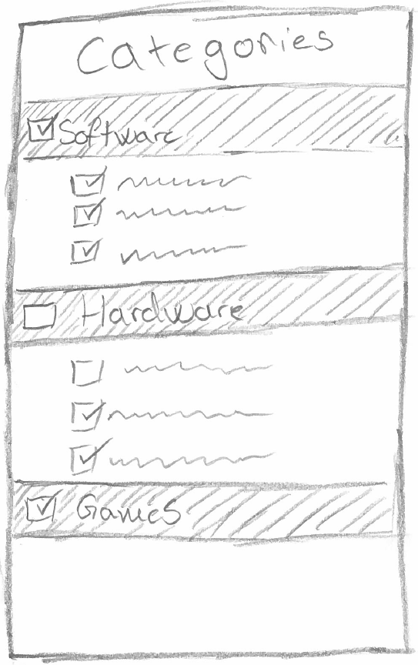
Motivation
concept
App design
Floor plan
Website
Server communication
conclusion
demonstration
TeST
8 OF 17 | 15.02.2014
Department of computer science
AALBORG UNIVERSITy

Slide 10
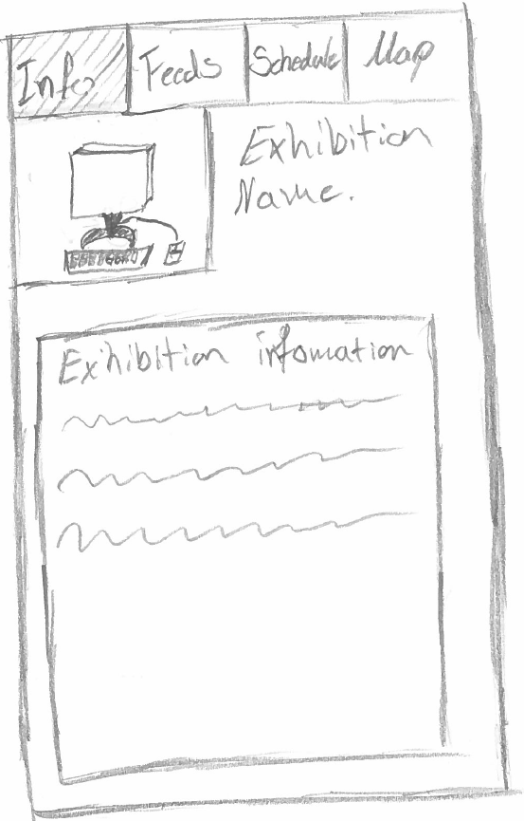
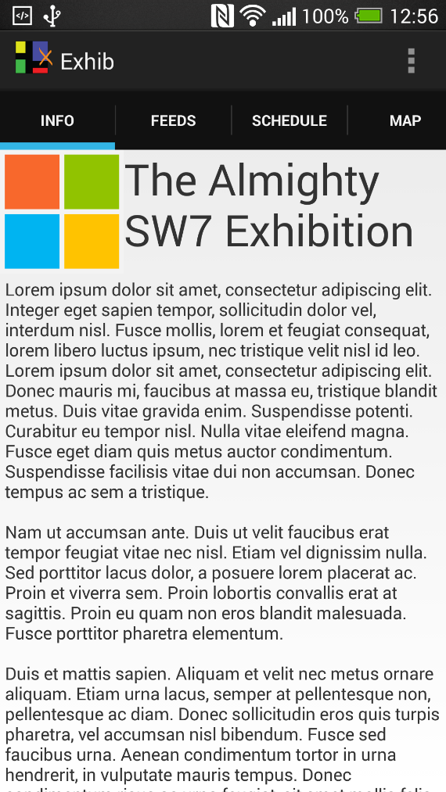
Motivation
concept
App design
Floor plan
Website
Server communication
conclusion
demonstration
TeST
8 OF 17 | 15.02.2014
Department of computer science
AALBORG UNIVERSITy

Slide 11
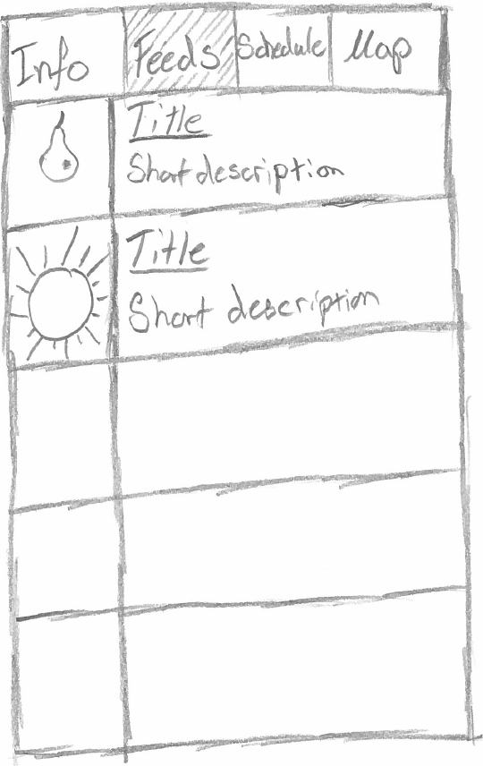
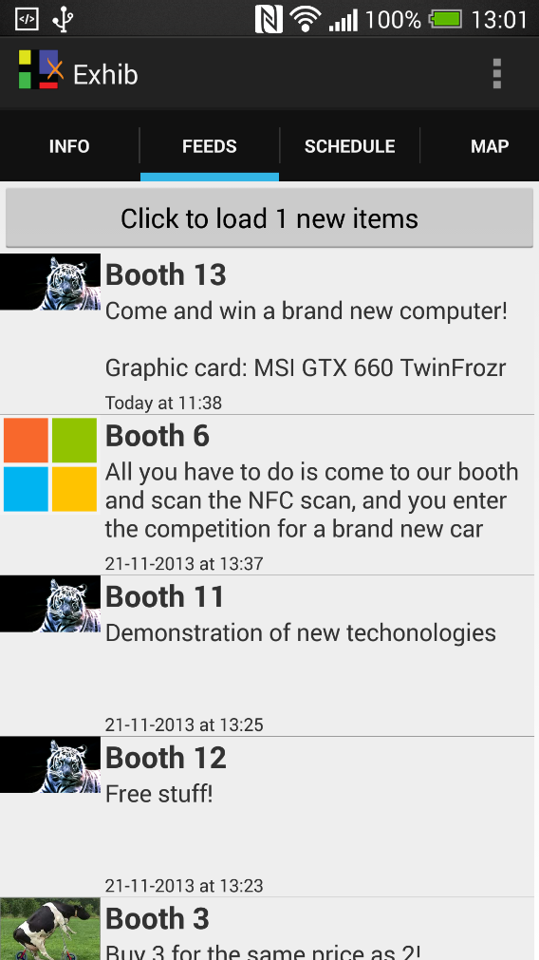
Motivation
concept
App design
Floor plan
Website
Server communication
conclusion
demonstration
TeST
8 OF 17 | 15.02.2014
Department of computer science
AALBORG UNIVERSITy

Slide 12
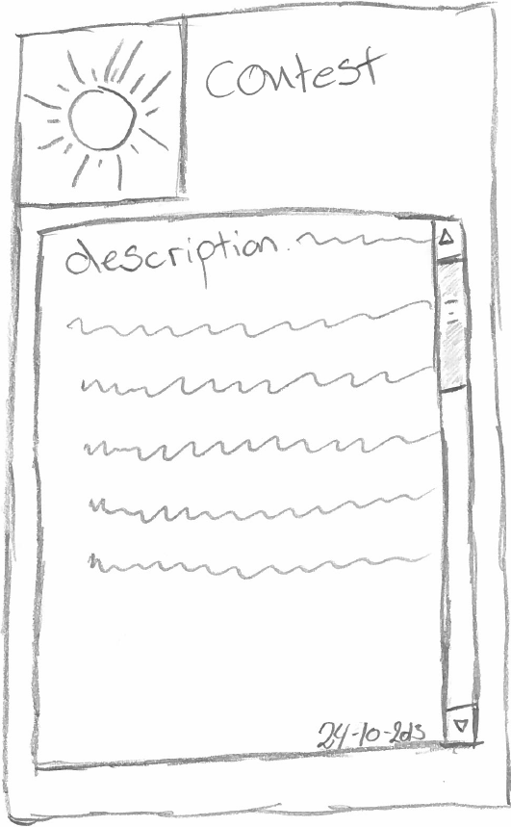
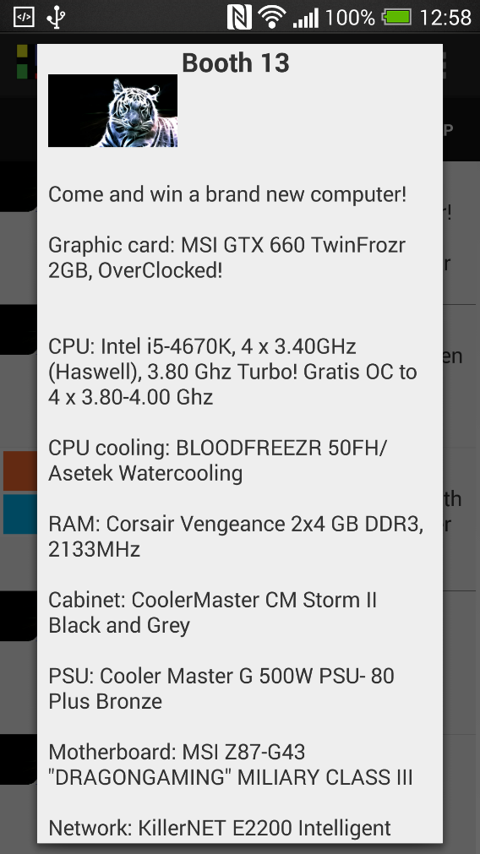
Motivation
concept
App design
Floor plan
Website
Server communication
conclusion
demonstration
TeST
8 OF 17 | 15.02.2014
Department of computer science
AALBORG UNIVERSITy

Slide 13
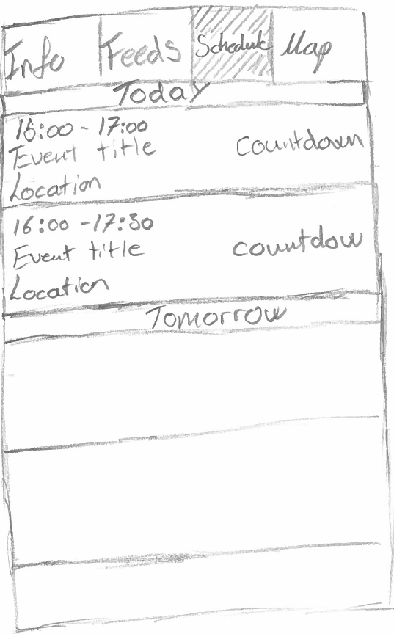
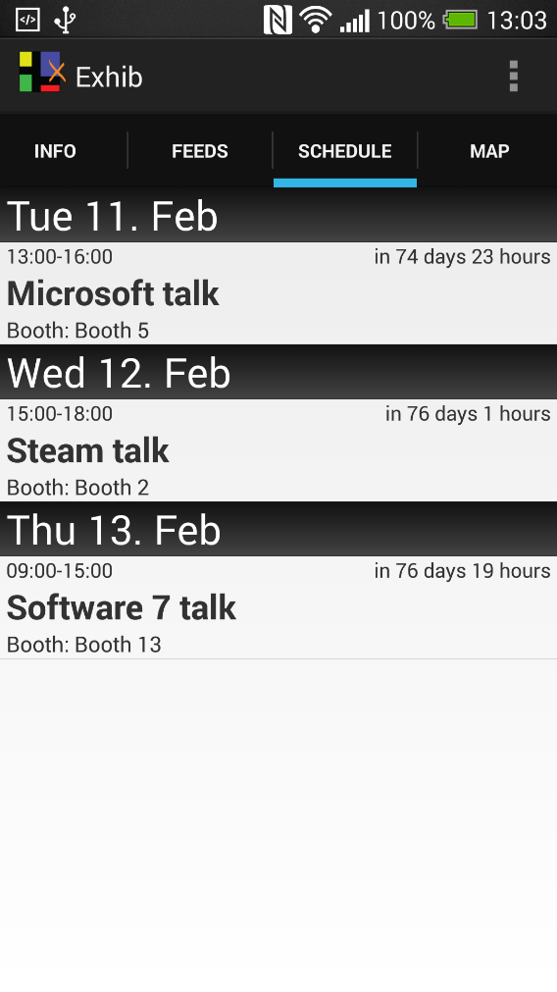
Motivation
concept
App design
Floor plan
Website
Server communication
conclusion
demonstration
TeST
8 OF 17 | 15.02.2014
Department of computer science
AALBORG UNIVERSITy

Slide 14
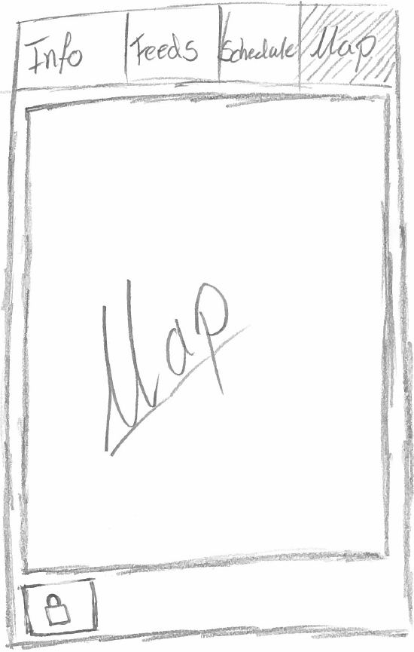
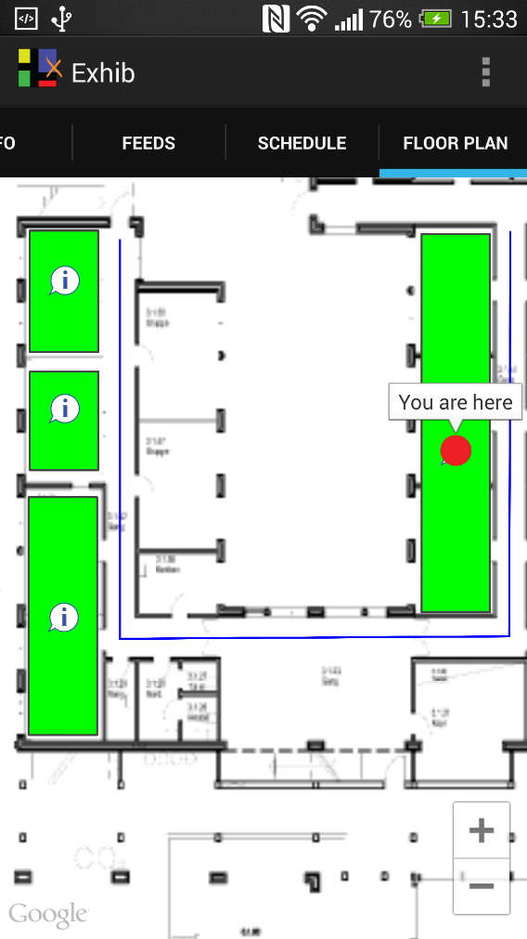
Motivation
concept
App design
Floor plan
Website
Server communication
conclusion
demonstration
TeST
8 OF 17 | 15.02.2014
Department of computer science
AALBORG UNIVERSITy

Slide 15
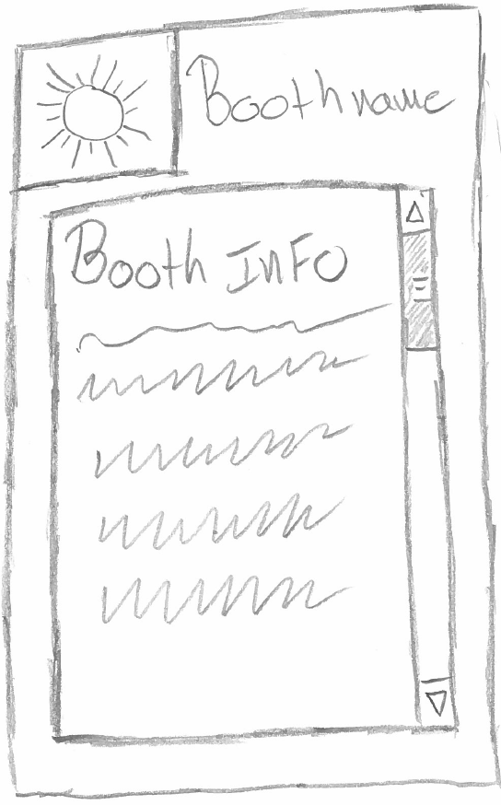
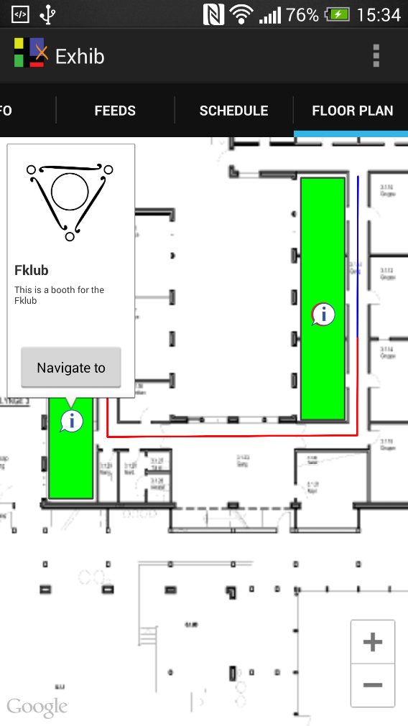
Motivation
concept
App design
Floor plan
Website
Server communication
conclusion
demonstration
TeST
8 OF 17 | 15.02.2014
Department of computer science
AALBORG UNIVERSITy

Slide 16
Floor Plan
Jesper R. Andersen

Slide 17
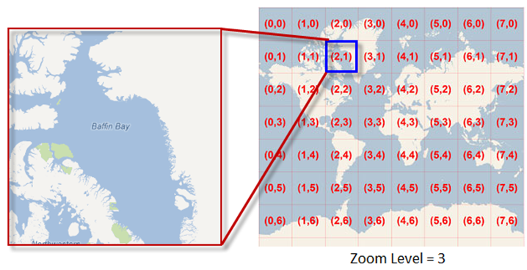
Motivation
concept
App design
Floor plan
Website
Server communication
conclusion
demonstration
Floor plan
Webview vs. mapfragment
Performance
Tile set
10 OF 17 | 15.02.2014
Department of computer science
AALBORG UNIVERSITy

Slide 18
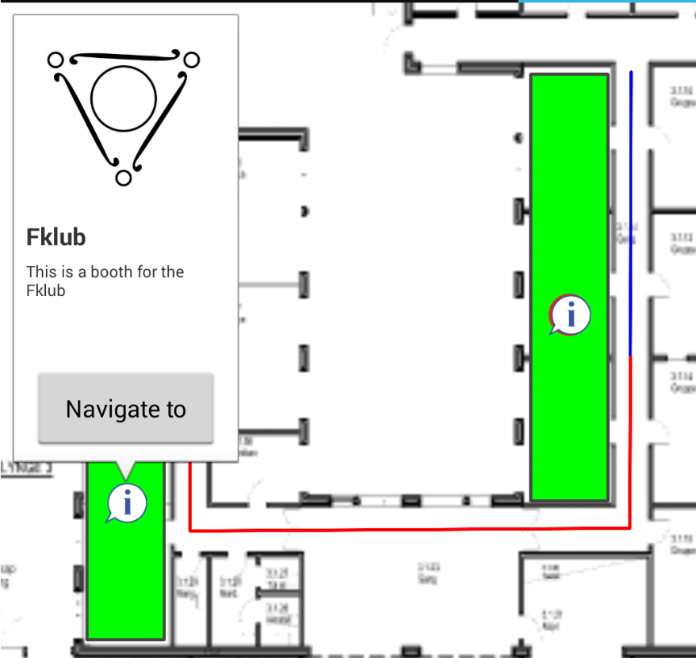
Motivation
concept
App design
Floor plan
Website
Server communication
conclusion
demonstration
Floor plan
shapes and elements
Makers
Polygons
Polylines
Info window
10 OF 17 | 15.02.2014
Department of computer science
AALBORG UNIVERSITy

Slide 19
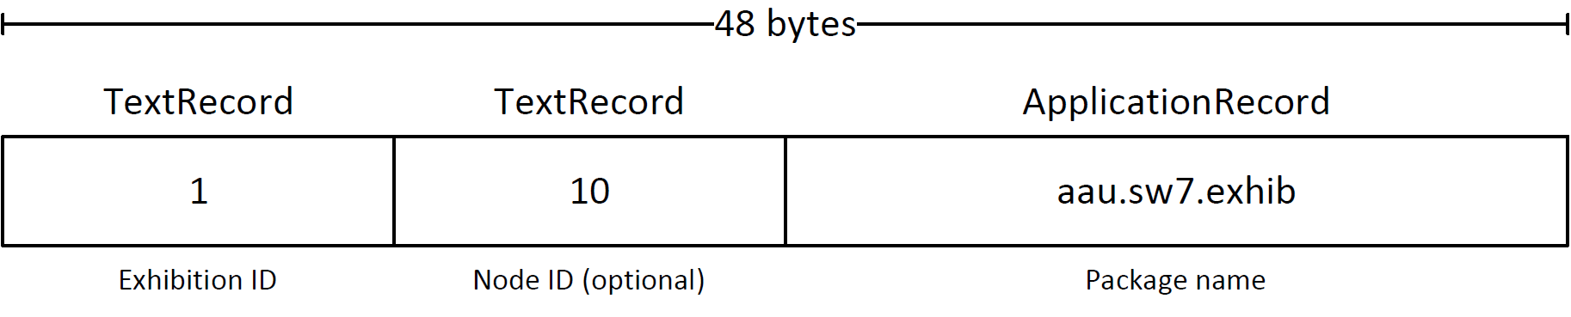
Motivation
concept
App design
Floor plan
Website
Server communication
conclusion
demonstration
NFC
NFC Tag data
NFC implementation
10 OF 17 | 15.02.2014
Department of computer science
AALBORG UNIVERSITy

Slide 20
Website
Henrik Klarup

Slide 21
Motivation
concept
App design
Floor plan
Website
Server communication
conclusion
demonstration
website Tool
Administration tool
Feeds
Company
Exhib
Schedule
Floor plan
12 OF 17 | 15.02.2014
Department of computer science
AALBORG UNIVERSITy

Slide 22
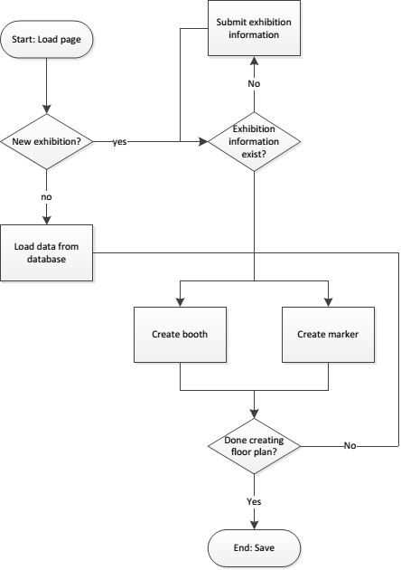
Motivation
concept
App design
Floor plan
Website
Server communication
conclusion
demonstration
Website flow
12 OF 17 | 15.02.2014
Department of computer science
AALBORG UNIVERSITy

Slide 23
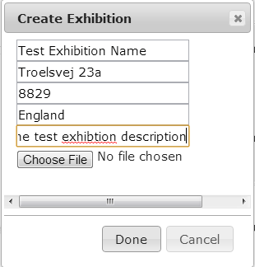
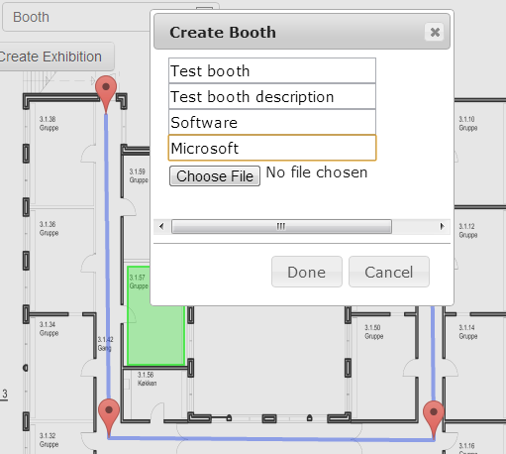
Motivation
concept
App design
Floor plan
Website
Server communication
conclusion
demonstration
Website creation
12 OF 17 | 15.02.2014
Department of computer science
AALBORG UNIVERSITy

Slide 24
Motivation
concept
App design
Floor plan
Website
Server communication
conclusion
demonstration
Features of the website
Features
Create and edit exhibitions
Create feeds and schedules
Create an exhibition floor plan
Missing Features
Login system
Automatic tile creation from website
12 OF 17 | 15.02.2014
Department of computer science
AALBORG UNIVERSITy

Slide 25
Server Communication
Nicklas Andersen

Slide 26
Motivation
concept
App design
Floor plan
Website
Server communication
conclusion
demonstration
TeST
TEST
TeST
Department of computer science
AALBORG UNIVERSITy

Slide 27
Results and Findings
Jacob K. Wortmann

Slide 28
Motivation
concept
App design
Floor plan
Website
Server communication
conclusion
demonstration
Conclusion
We implemented a website tool, android application, and a server service
All three parts functions and work well with each other
Personalise the application with relevant information.
WE believe that the application will help navigation issues.
Department of computer science
AALBORG UNIVERSITy

Slide 29
Live Demo
Nicklas and Jesper

